Slide 1
Mutual Fund Performance Prediction App
Joshua Lee
Michael Peters

Slide 2
Goal
Methods
Create an app to help make investment decisions.
Defined 5 large mutual funds for the user to choose from.
Display a collection of information on the mutual funds.
Use a machine learning model to predict future performance of the mutual that was chosen.
API for calling Historical Fund Data
Yfinance.
API for running forecast model
Provided by Nixtla open source time series ecosystem.
TimeGPT - Pre-trained model for forecasting.
Facebook Prophet- Forecasting
Streamlit
App development, and data visualization.

Slide 3
Approach
Utilized Jupyter Notebooks - troubleshoot as we ran cell by cell.
Exported Jupyter Notebook to Python file after troubleshooting code.
When implementing code functions into stream interface debug any problems that arose as needed.

Slide 4
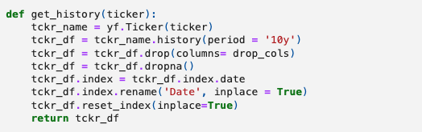
Data Preparation
Used yfinance API to pull ticker data for each Mutual Fund(VTSAX, VFIAX, VTIAX, FXAIX, VBTLX)
Dropped any unnecessary columns and Na
Focus dataframe on “Date” and “Close” prices.

Slide 5
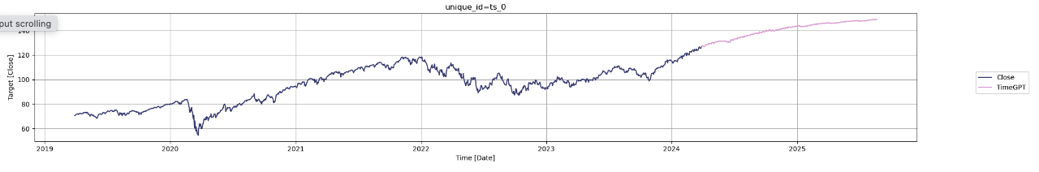
Forecasting Models
TimeGPT- Nixtla’s TimeGPT is a pre-trained model for time series forecasting, generating accurate predictions using historical data alone. TimeGPT processes time series data sequentially,, predicting future values based on identified patterns. Its API enables users to utilize its forecasting abilities for future event prediction and other time series tasks like anomaly detection and scenario analysis.
Within the TimeGPT API, there are various methods of forecasting. We chose the Long Horizon models, with fine-tuning implemented.

Slide 6
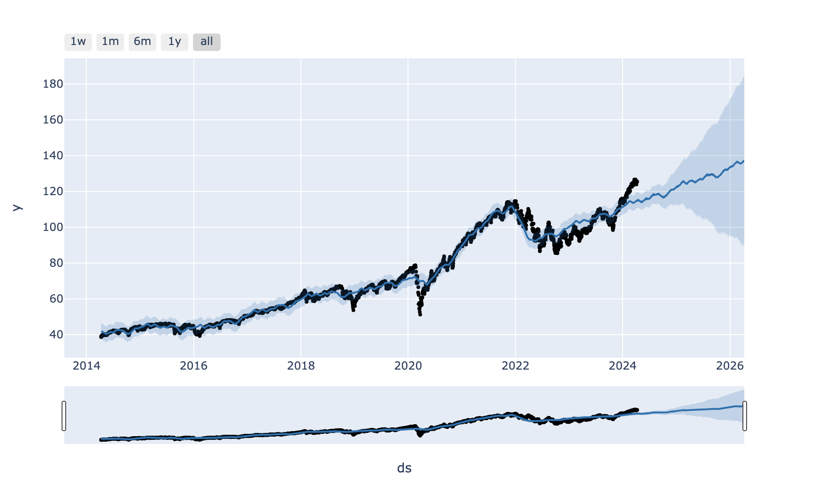
Forecasting Models
Facebook Prophet- Prophet is an open-source tool that is easy to use and requires minimal data preprocessing. It can automatically detect seasonality, trends, and holidays in the data and produce forecasts that are typically more accurate than traditional methods for many business time series datasets.

Slide 7
Trial and Error
Nixtla Ecosystem
StatsForecast
Did not like datatypes in dataframe when trying to fit the model.
'str' object has no attribute 'prediction_intervals'
‘Int’ object has no attribute ‘h’
MLForecast
Predictions were the same for future dates.
NeuralForecast
Slow model to run.
When using it to predict future data, it didn’t like the the datatype inside the dataframe.
Streamlit
Had an issue with the data frames that were being creating not being saved as you use the app.
The solution we used was the session state to store values.
Additional Forecast Models
ARIMA Model(Predicted Polar Results)

Slide 8
Potential Next Steps
Assessing the performance of the forecast models that we created.
Implementing number input box to allow users to set an initial investment amount, and number of months to run the prediction for.
Instead of only allowing the user to choose between predefined funds, allow them to provide a ticker and predict on the stock or mutual fund.

Slide 9
Any Questions?

